Slide 1
Capstone project
Car accident Severity
Done By :Makram Hatoum

Slide 2
2. Introduction

Slide 3
1.1 Background
The whole world is looking for a way to prevent car accidents from happening in their area car accidents can cause a several of problems to both governments and individuals Fatalities and car jamming are part of the problems added on that the cost of health care systems

Slide 4
1.2 Problem
Seattle is like any other place in the world suffer from car accident and according to collision data 30% Of mischance leads to harm collision which is close to 1/3 of all car accidents this considered a tall number. our mission is to try to know the pattern of these accident and if we can predict what cause the high count of severities.

Slide 5
1.3 Stakeholders
The intended interest group of this project is Seattle government, police, salvage gatherings, and to wrap things up, vehicle protection foundations. The model and its outcomes will give some guidance to the intended interest group to settle on smart choices for diminishing the quantity of accidents and severity

Slide 6
2. Understanding Data

Slide 7
2.1 Data Cleaning
There is a great deal of issues in the informational collection. The dataset has complete perceptions of 194673 record with variety of records that can be used. Above all else, the all-out dataset was high variety in the lengths of pretty much every segment of the dataset. The dataset had a great deal of void segments which could have been useful if the information had been available there. These segments included speed or not, cross walk key, hit parked car,
In order to proceed we have first to clean our data as mentioned we have a lot null values in valuable columns like weather, road condition, and light condition (visibility) we will drop the rows that contains null values in this columns we will also drop the rows that contains any unknown data like (unknown and others) we will also replace the text into integers
In weather we will replace Clear by 0 Blowing Sand Dirt Fog/Smog/Smoke by 2 Overcast by 3 Partly Cloudy by 4 Raining by 5 Severe Crosswind by 6 Sleet/Hail/Freezing by 7 Snowing by 8
road condition we will replace Wet by 0 Dry by 1 Snow/Slush by 2 Ice by 3 Sand/Mud/Dirt by 4 Standing Water by 5 Oil by 6
light condition we will replace Daylight by 0 Dark - Street Lights On by 1 Dark - No Street Lights by 2 Dusk by 3 Dawn by 4 Dark - Street Lights Off by 5 Dark - Unknown Lighting by 6
address type we will replace Intersection by 0 Block by 1 Alley 2
we tried to use SPEEDING but we find that a lot of fields are null only 4.8 % have data wich mean we cannot use it as predic

Slide 8
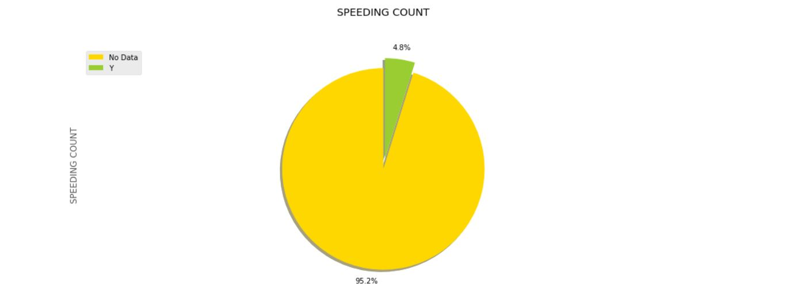

Slide 9
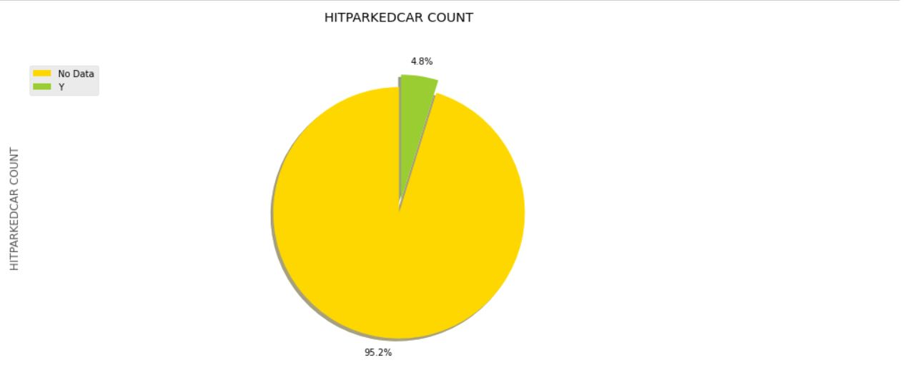

Slide 10
3.1 Data Collection
The dataset utilized for this venture depends on auto collisions which occurred inside the city of Seattle, Washington from the year 2004 to 2020. This information is in regards to auto crashes the seriousness of every auto collision alongside the time and conditions under which every mishap happened

Slide 11
3.2 Exploratory Analysis
After exploring we found that are some are irrelevant and some of the data are missed so the first thing that we do is to clean the data from null values and we will also clean the data form values like Unknown and other since even if we use them as predictor we will not have any meaningful result of them

Slide 12
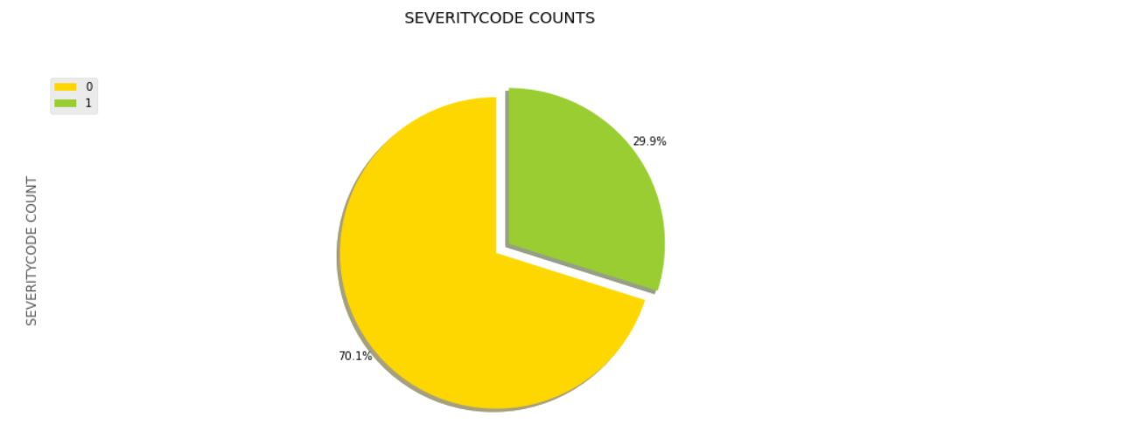
Data of severity distribution before balancing

Slide 13
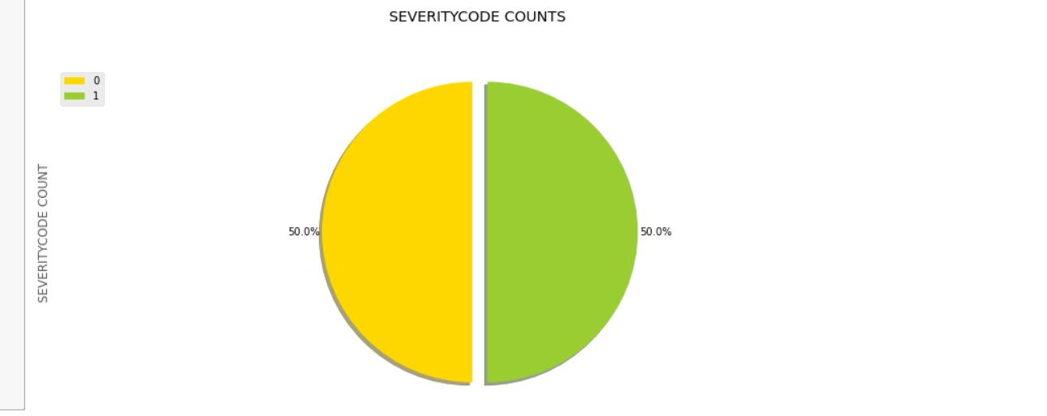
Data of severity distribution after balancing

Slide 14
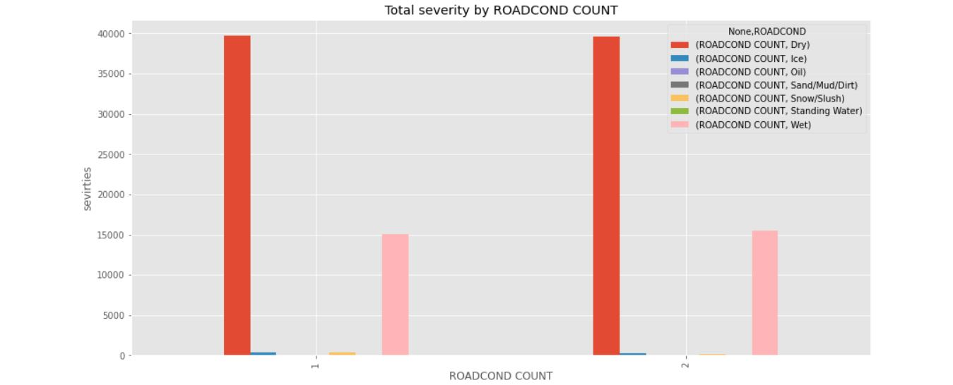

Slide 15
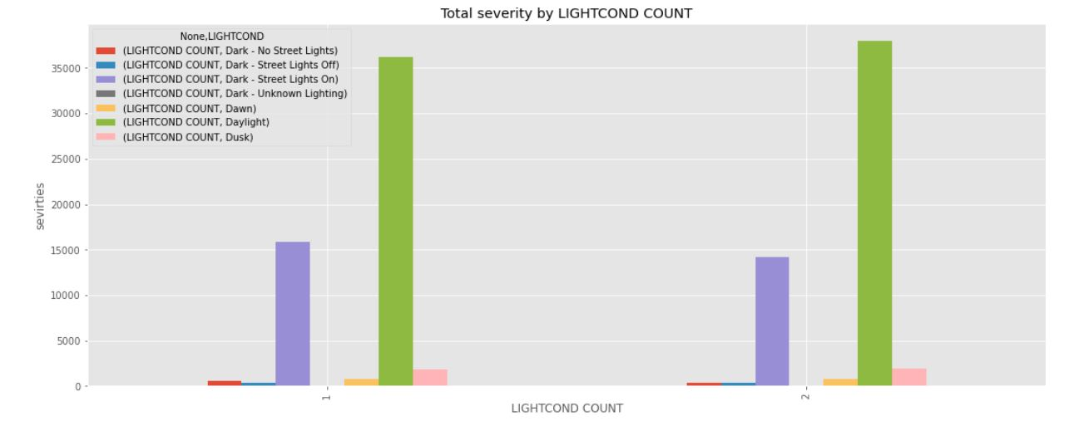

Slide 16
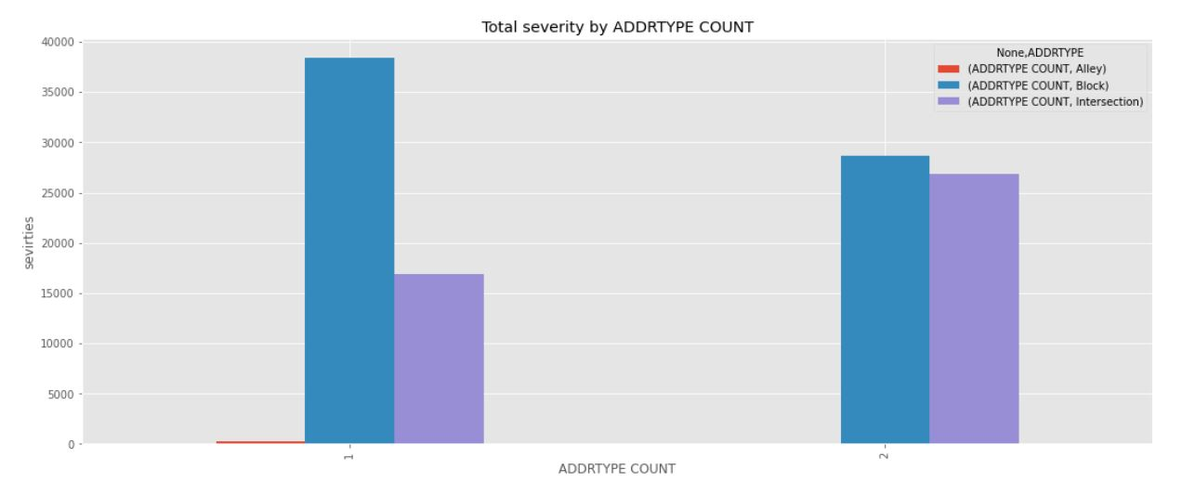

Slide 17
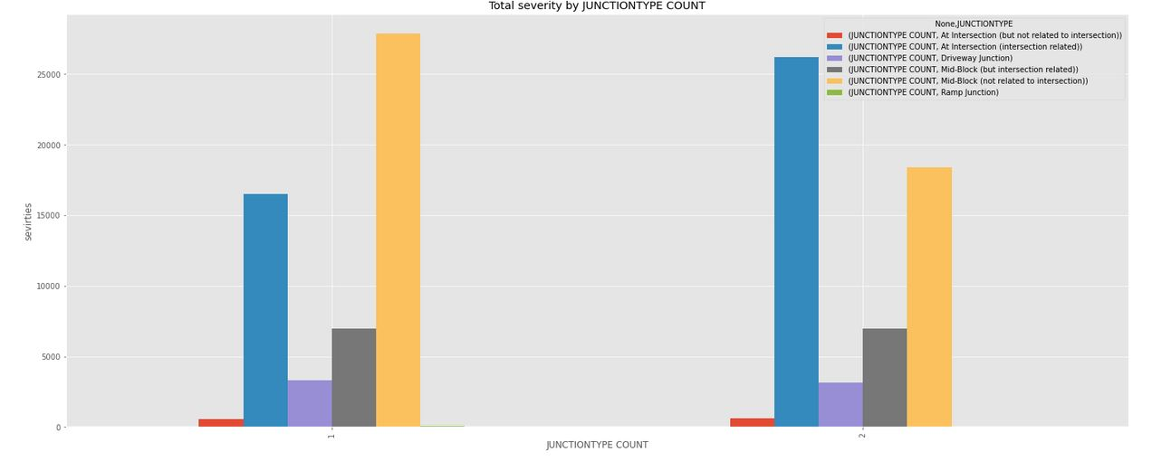

Slide 18
3.3 Machine Learning Model Selection

Slide 19
We will try different model to train and we will choice the best on oh them
k-nearest neighbors
NVM
Logistic Regression
Decision-Tree Classifier

Slide 20
4. Results

Slide 21
4.1 k-nearest neighbors
train set accuracy: 0.5730409436008677 test set accuracy: 0.574295010845987

Slide 22
4.2 SVM
train set accuracy: 0.5911175885755604 test set accuracy: 0.5876265365148229

Slide 23
4.3 Logistic Regression
train set accuracy: 0.5886546456977585 test set accuracy: 0.5841467823571945

Slide 24
4.4 Decision Tree
train set accuracy: 0.5014280549530007 test set accuracy: 0.5871475054229935

Slide 25
5. Discussion
According to the above table we make the decision to use SVM model since it have the highest F1-score
Algorithm | Jaccard | F1-score
KNN | 0.342225 | 0.566901
Decision Tree | 0.413015 | 0.587134
SVM | 0.424762 | 0.587402
LogisticRegression | 0.451674 | 0.579692

Slide 26
6. Conclusion
According to the data taken coursera and by using WEATHER, ROADCOND, LIGHTCOND, ADDRTYPE, JUNCTIONTYPE as predictors we find that we can’t rely very much on them since the best prediction percent is less than 80% and even if we use more predictors from the data we will find that these predictors have a lot of biased information like speeding for example in this case we don’t know the type of drivers that are using the road and if they are speeders or not

